Slide 1

Mobile Application Development
Welcome
Class: BS(CS)-VII
Sukkur IBA University – Kandhkot Campus
Week - 09
Lecture – 18
Your Facilitator, Adil Khan

Slide 2
AsyncTask

Slide 3
The UI thread
When an Android app starts, it creates the main thread, which is often called the UI thread.
The UI thread dispatches events to the appropriate user interface (UI) widgets.
The UI thread is where your app interacts with components from the Android UI toolkit (components from the android.widget and android.view packages).

Slide 4
The UI thread
Android's thread model has two rules:
Do not block the UI thread.
Do UI work only on the UI thread.
The UI thread needs to give its attention to drawing the UI and keeping the app responsive to user input.
If everything happened on the UI thread, long operations such as network access or database queries could block the whole UI.

Slide 5
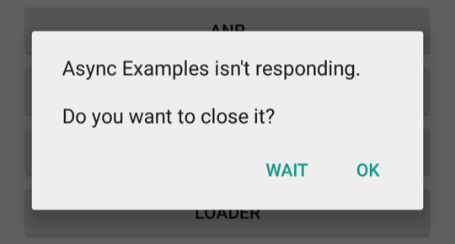
The UI thread
If the UI thread were blocked for more than a few seconds (about 5 seconds currently) the user would be presented with the "application not responding" (ANR) dialog.
To make sure your app doesn't block the UI thread:
Complete all work in less than 16 ms for each UI screen.
Don't run asynchronous tasks and other long-running tasks on the UI thread. Instead, implement tasks on a background thread using AsyncTask (for short or interruptible tasks) or AsyncTaskLoader (for tasks that are high-priority, or tasks that need to report back to the user or UI).

Slide 6
What is a long running task?
Network operations
Long calculations
Downloading/uploading files
Processing images
Loading data

Slide 7
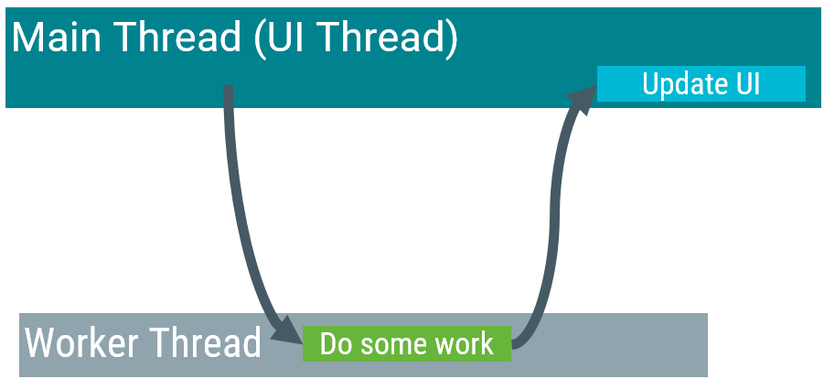
AsyncTask
A worker thread is any thread which is not the main or UI thread. Use the AsyncTask class to implement an asynchronous, long-running task on a worker thread.
AsyncTask allows you to perform background operations on a worker thread and publish results on the UI thread.

Slide 8
AsyncTask
When AsyncTask is executed, it goes through four steps:
onPreExecute() is invoked on the UI thread before the task is executed. This step is normally used to set up the task, for instance by showing a progress bar in the UI.
doInBackground(Params...) is invoked on the background thread immediately after onPreExecute() finishes. This step performs a background computation, returns a result, and passes the result to onPostExecute(). The doInBackground() method can also call publishProgress(Progress...) to publish one or more units of progress.
onProgressUpdate(Progress...) runs on the UI thread after publishProgress(Progress...) is invoked. Use onProgressUpdate() to report any form of progress to the UI thread while the background computation is executing. For instance, you can use it to pass the data to animate a progress bar or show logs in a text field.
onPostExecute(Result) runs on the UI thread after the background computation has finished. The result of the background computation is passed to this method as a parameter.

Slide 9
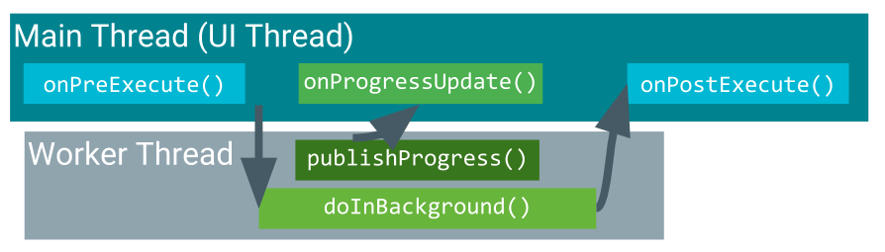
AsyncTask

Slide 10
AsyncTask Usage
We mainly override two methods:
doInBackground()—runs on a background thread
All the work to happen in the background
onPostExecute()—runs on main thread when work done
Process results
Publish results to the UI
To use the AsyncTask class, define a subclass of AsyncTask that overrides the doInBackground(Params...) method (and usually the onPostExecute(Result) method as well).

Slide 11
AsyncTask Usage
In your subclass of AsyncTask, provide the data types for three kinds of parameters:
"Params" specifies the type of parameters passed to doInBackground() as an array.
"Progress" specifies the type of parameters passed to publishProgress() on the background thread. These parameters are then passed to the onProgressUpdate() method on the main thread.
"Result" specifies the type of parameter that doInBackground() returns. This parameter is automatically passed to onPostExecute() on the main thread.
Specify a data type for each of these parameter types, or use Void if the parameter type will not be used.

Slide 12
AsyncTask Usage
In this class declaration:
The "Params" parameter type is String, which means that MyAsyncTask takes one or more strings as parameters in doInBackground(), for example to use in a query.
The "Progress" parameter type is Void, which means that MyAsyncTask won't use the publishProgress() or onProgressUpdate() methods.
The "Result" parameter type is Bitmap. MyAsyncTask returns a Bitmap in doInbackground(), which is passed into onPostExecute().

Slide 13
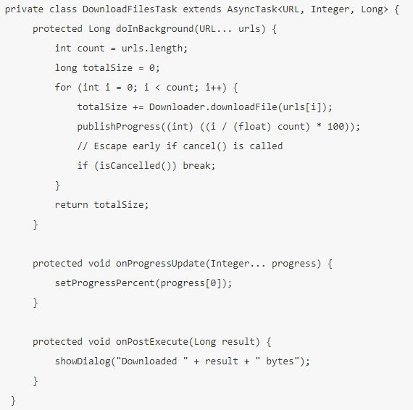
AsyncTask Example

Slide 14
AsyncTask Example
The example above goes through three of the four basic AsyncTask steps:
doInBackground() downloads content, a long-running task. It computes the percentage of files downloaded from the index of the for loop and passes it to publishProgress(). The check for isCancelled() inside the for loop ensures that if the task has been cancelled, the system does not wait for the loop to complete.
onProgressUpdate() updates the percent progress. It is called every time the publishProgress() method is called inside doInBackground(), which updates the percent progress.
doInBackground() computes the total number of bytes downloaded and returns it. onPostExecute() receives the returned result and passes it into onPostExecute(), where it is displayed in a dialog.

Slide 15

Executing an AsyncTask
After you define a subclass of AsyncTask, instantiate it on the UI thread.
Then call execute() on the instance, passing in any number of parameters. (These parameters correspond to the "Params" parameter type discussed above).

Slide 16
Limitations of AsyncTask
AsyncTask is impractical for some scenarios:
Changes to device configuration cause problems.
When device configuration changes while an AsyncTask is running, for example if the user changes the screen orientation, the activity that created the AsyncTask is destroyed and re-created.
The AsyncTask is unable to access the newly created activity, and the results of the AsyncTask aren't published.

Slide 17
Limitations of AsyncTask
AsyncTask is impractical for some scenarios:
Old AsyncTask objects stay around, and your app may run out of memory or crash.
If the activity that created the AsyncTask is destroyed, the AsyncTask is not destroyed along with it. For example, if your user exits the app after the AsyncTask has started, the AsyncTask keeps using resources unless you call cancel().

Slide 18
Thank you!
Any Questions???

